Slide 1

Surveying Merit Badge
Teaching the Rising Generation about our Profession

Slide 2
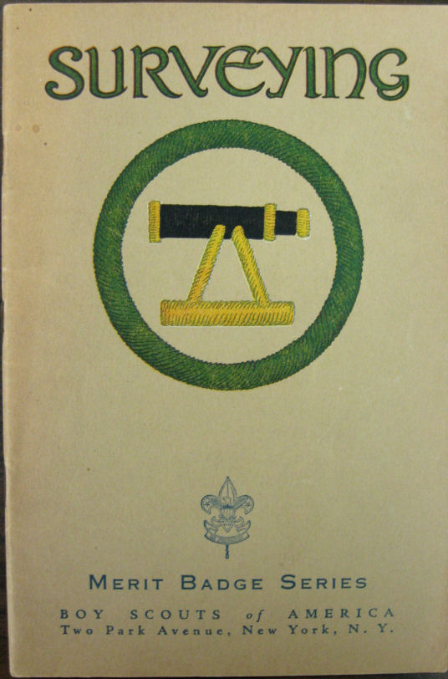
Surveying Merit Badge Facts
One of the original 57 merit badges in 1911
142,583 Badges have been awarded
1,166 were awarded in 2007

Slide 3

Why Teach Merit Badges
Captive Audience
Lesson Materials
Small time commitment

Slide 4

Engaged Audience
Scouts come to the merit badge class interested in the topic, having chosen it over other badges
It allows us to highlight all aspects of the profession.
Career fairs and other forms of familiarizing young people with surveying are more of a sales pitch.

Slide 5
Lesson Materials are Available
Established requirements and topics to discuss, no need to create a new message.
Experienced help, many surveyors have participated as instructors.
Worksheets, workflows and other materials available online or from the Public Relations Committee.

Slide 6
Small Time Commitment
Entire merit badge can be completed in approximately 4 hours.
Often local districts hold merit badge clinics, pow-wows, or fairs and provide structure and meals to the scouts.
Many clinics divide the classes into two days, often two consecutive Fridays or Saturdays.

Slide 7
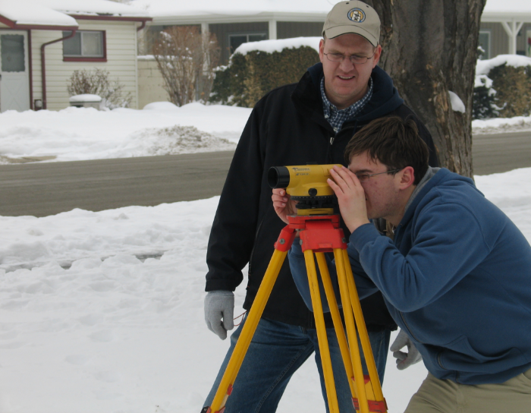
Lesson format
First 2 Hours
First Aid
5 point traverse
2 side shots
Leveling exercise
Discuss GPS
Second 2 hours
Compute Closure (<5 feet)
Draw map to scale
Write metes and bounds description
Discuss Surveying with LS
Homework
Obtain copy of deed

Slide 8
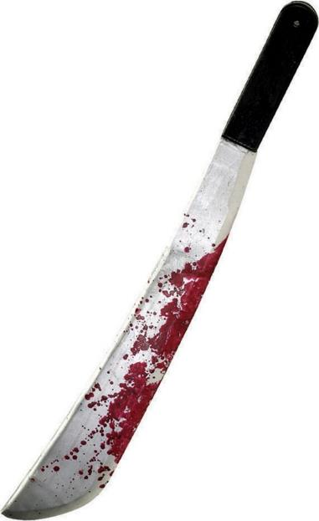
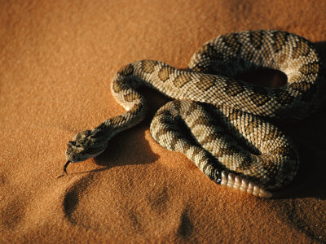
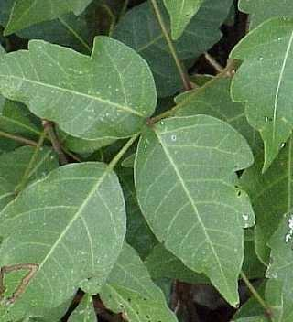
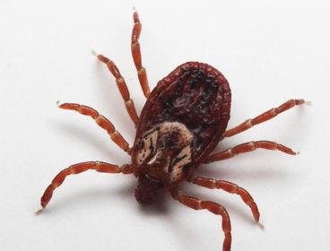
First Aid
Show that you know first aid for the types of injuries that could occur while surveying, including cuts, scratches, snakebite, insect stings, tick bites, heat and cold reactions, and dehydration. Explain to your counselor why a surveyor should be able to identify the poisonous plants and poisonous animals that are found in your area.

Slide 9
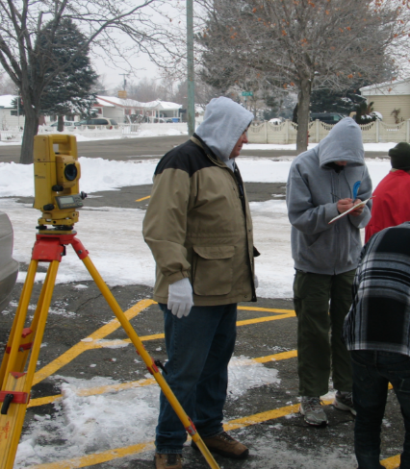
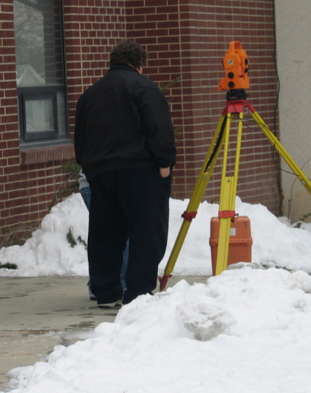
5 sided traverse
Find and mark the corners of a five-sided lot that has been laid out by your counselor to fit the land available. Set an instrument over each of the corners and record the angle turned between each line and the distance measured between each corner, as directed by your counselor. With the assistance of the counselor, compute the error of closure from the recorded notes. The error of closure must not be more than 5 feet. From the corners, take compass readings or turn angles to trees, shrubs, and rocks and measure to them. All measurements should be made using instruments, methods, and accuracies consistent with current technology.
Since the equipment to be used in any surveying job is dependent on the accuracy needed, and five feet is pretty loose, most any technology can be employed. Exposing the scouts to a variety of gear is useful.
Most effective setup seems to be compass and tape for up to three legs and total station or two for the remainder.
Divide scouts into crews of two to three scouts.
All lines and azimuths/angles can be measured by each boy, crew can average measurements.

Slide 10
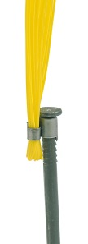
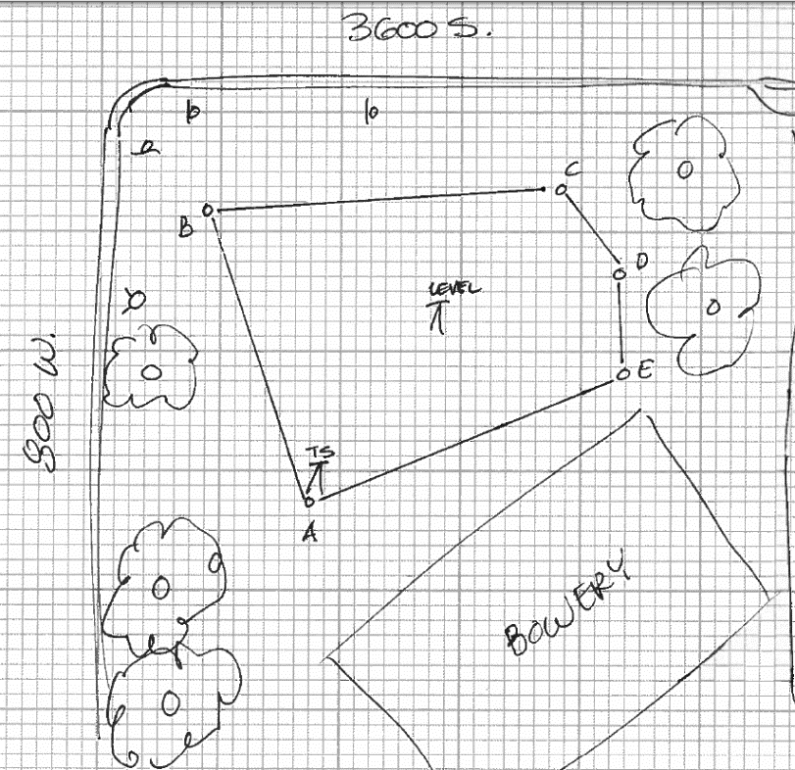
Leveling Exercise
Use one of the corner markers from requirement 2 as a benchmark with an assumed elevation of 100 feet. Using a level and rod, determine the elevation of the other four corner markers
Crews rotate between total station, compass and tape, and level for large groups, for smaller groups do the leveling after

Slide 11

Discuss GPS
Tell what GPS is; discuss with your counselor the importance of GPS and how it is changing the field of surveying.

Slide 12
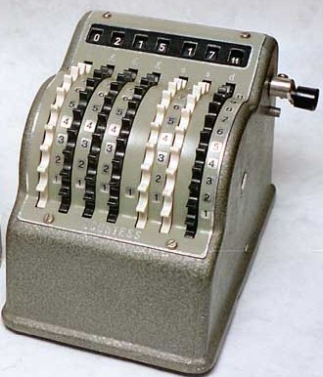
Note Reduction
With the assistance of the counselor, compute the error of closure from the recorded notes. The error of closure must not be more than 5 feet.
Average the results from all crews, throw out the bad measurements and do calculations as a group using averaged numbers.
From the field notes gathered for requirement 2, draw to scale a map of your survey. Submit a neatly drawn copy.
Use graph paper, protractors, scales not needed
Write a metes and bounds description for the five-sided lot in requirement 2.

Slide 13
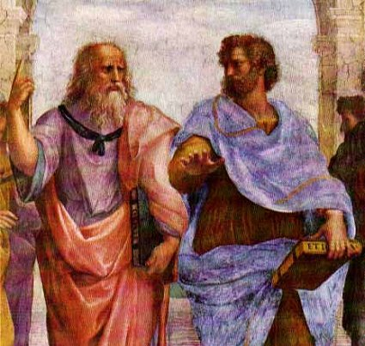
Discussion
Discuss the importance of surveying with a licensed surveyor. Also discuss the various types of surveying and mapping, and applications of surveying technology to other fields. Discuss career opportunities in surveying and related fields. Discuss qualifications and preparation for such a career.
The scouts are typically as excited about emerging [measuring] technologies as surveyors are. Talking about scanning, imaging or UAV’s could help keep their attention.

Slide 14

Homework
Get a copy of the deed to your property, or a piece of property assigned by your counselor, from the local courthouse or title agency.
As an option, you could pull a deed and associated copies of search documents for the property you are meeting at and walk them through how you found that deed.
The scouts should be made aware that this should be done before class if it is a one day event.
A two day class can give procrastinators a second chance.

Slide 15
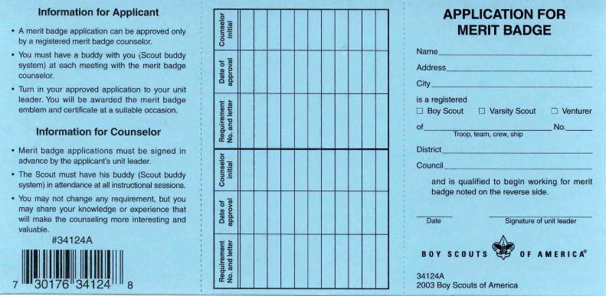
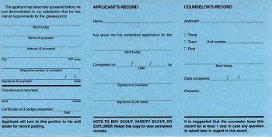
Sign off the scouts
Have one of the surveyors helping sign off the scouts as having completed the badge and give out contact information to those earning partial credit.
This allows the more ambitious to contact you, or work with another counselor when they are ready to pass off the remainder.
This will require a registered merit badge counselor, it is a simple process, however there are many UCLS members who are already registered and they could help with this.

